Slide 1
Touch Screen Kiosk
Team Members:
Maximilian Ellsberry,
Andrew Burcroff,
Stephen Wimsatt,
Mohammed Rasak

Slide 2

Introduction
Intro
Background
Design Decisions
Overall Design
Implementations
Security
Maintenance
Testing
Questions

Slide 3
Abstract
A web application project that serves as a Graphic User Interface (GUI) in three parts:
1. Web Browser
2. Vending Machine
3. Ad Displayer
We’ll also touch base on our remote server for hosting this application and it’s database.

Slide 4
The Background

Slide 5
Background for Client
CLIENT:
Professor @ WMU: Johnson Asumuda
Company: Ivend-net
Startup
GOAL:
Design a kiosk that will replace our standard vending machine
Lost of opportunity
Make the Internet more accessible
Start in Africa then move world wide

Slide 6

The Problem
PROBLEM:
Vending machines are a lost opportunity for those who need access to the Internet.

Slide 7
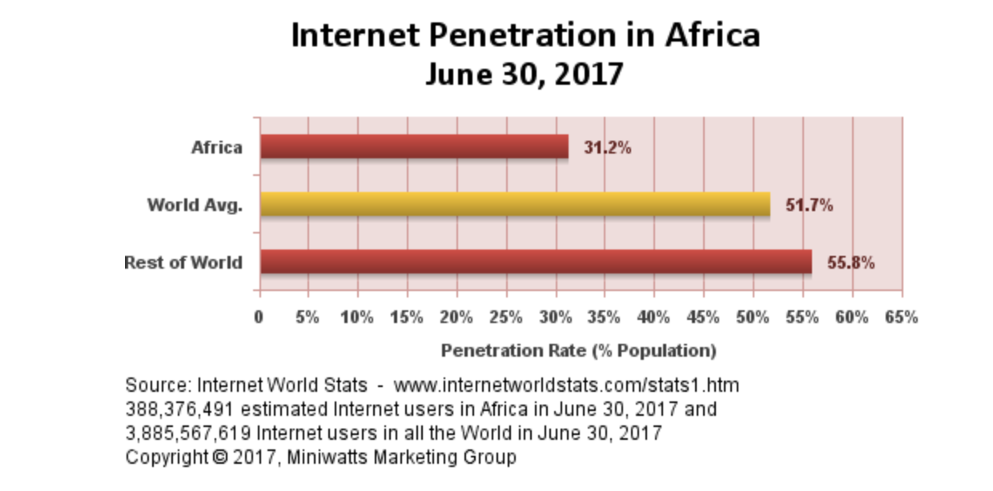
Some Perspective for Africa

Slide 8
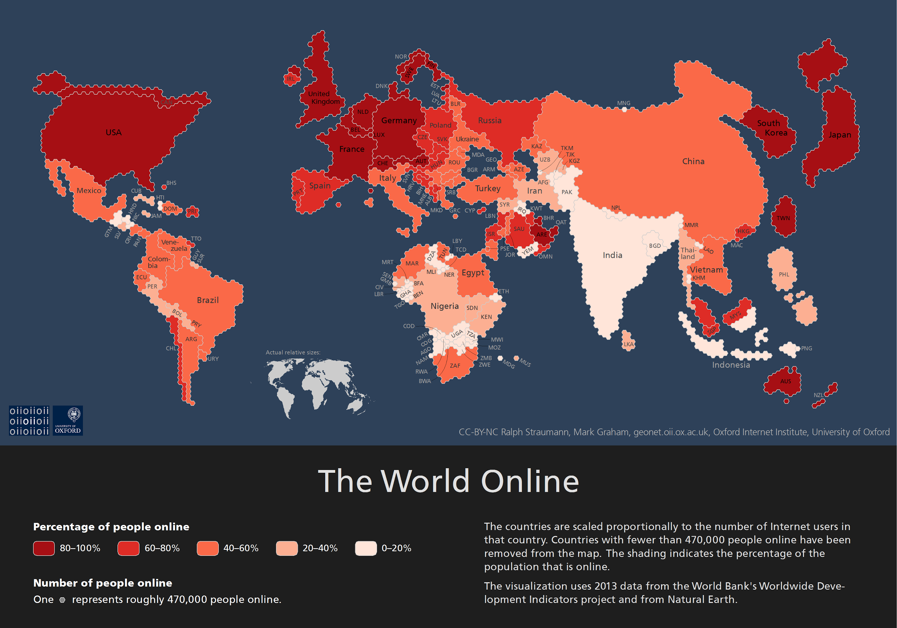
Some Perspective for World-Wide

Slide 9
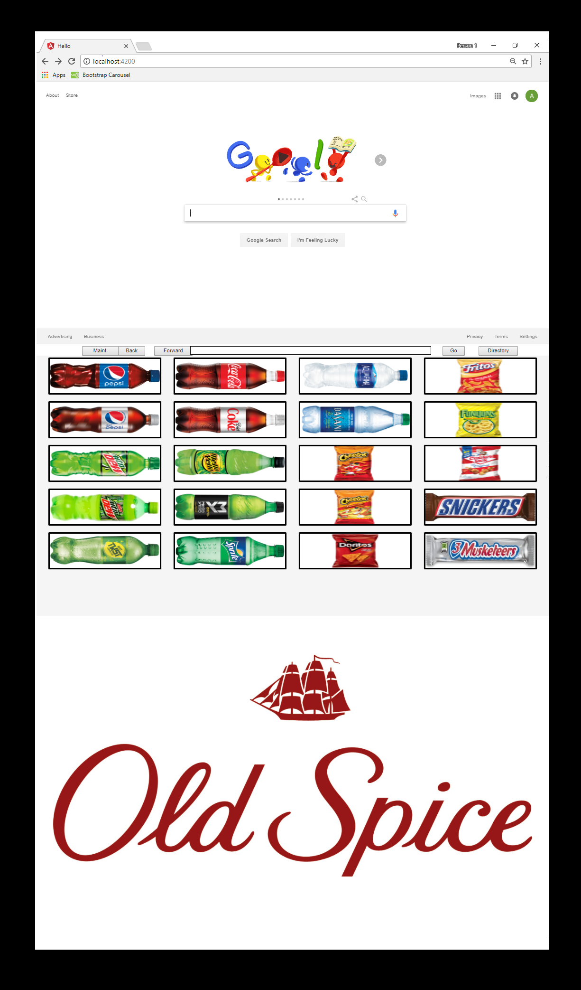
Solution
An all in one kiosk.
Possibility for customers/companies to make money on advertisements.
would allow for you to pay for items using digital currency.
This kiosk will have:
A Web Browser
Traditional Vending Machine
Advertisements

Slide 10
Design Decision
This project is meant to be proof of concept. This played a major role how we designed our project from the framework, operating system and etc.

Slide 11
Next Speaker: Max

Slide 12
Design Decision – Hardware
Client:
Picked out touch screen
Limited Documentation of Touch Screen(TS)
Drove us to make these design decisons

Slide 13

Design Decision – Operating System
Windows environment.
Buy some some hardware and build a custom computer that runs Windows.
Why Windows
Windows has the largest user base between all operating systems (OS)
Windows has much more support for hardware than most other operating such as Linux
Windows has great documentation.

Slide 14
The Cons of Windows
Because we decided to use Windows for our OS we knew it would come at the cost of:
Poor Security
The cost of third party software

Slide 15

Design Decision – Angular 2
Angular 2 framework with JavaScript
Kiosk a web application.
JavaScript Reason
Project is proof of concept and there will be a ton of moving hardware.
Having this as a web app allows it to be easily accessible to use and construct for all different types of hardware and it is OS independent.

Slide 16

Design Decision - AWS
Amazon Web Services (AWS) -backend
Easily scale up or down depending on our client’s needs.
we can have different server locations depending on location of the kiosk across the globe and this can lower latency.
Other Pros
Cheap
Great Documentation
Easy To Maintain
Scalability

Slide 17
Next Speaker: Stephen

Slide 18
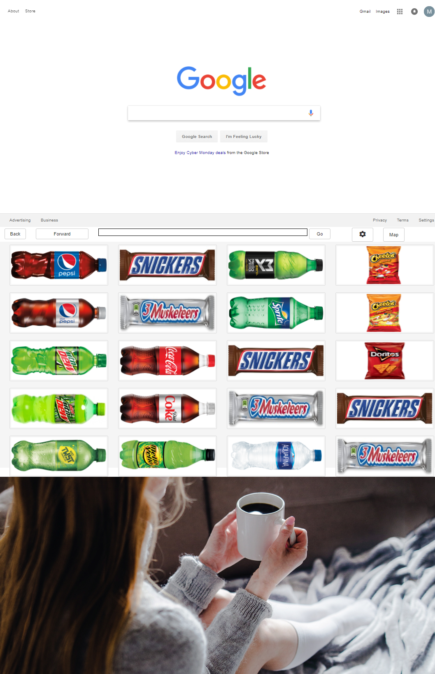
Implementation:Internet Partition
Visit any website
No Downloads
On-screen keyboard
Safe Pipe
Embedded Browser
Stand alone-browser

Slide 19

Known Issues: Internet Partition
URL hijacking
Under certain conditions the embedded browser will “hijack” the top level browser.
Browser History
History only stored when the URL bar is utilized.

Slide 20
Implementation: Vending Machine
Nutritional Info
Unique local items
Intuitive
IN THE FUTURE: Will accept any and all forms of currency
Where is everything's located?
Pictures Stored on AWS
Pulled from AWS server

Slide 21
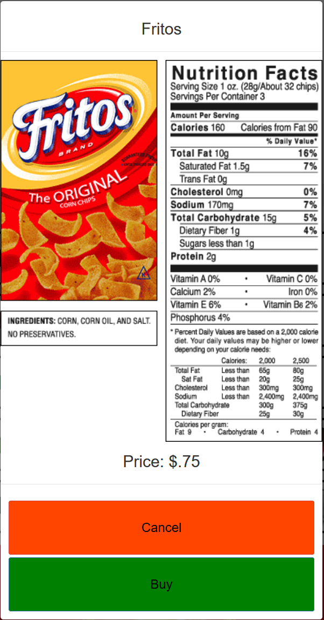
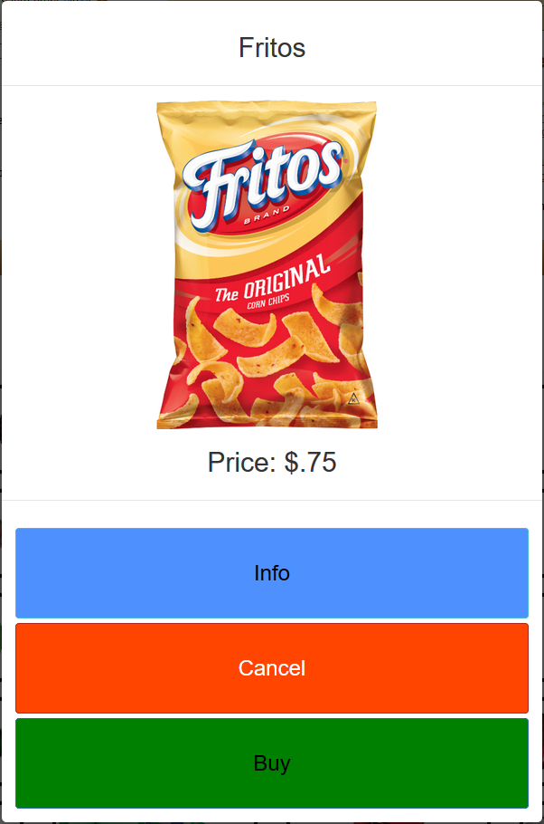
Implementation: Vending Machine
Each button stores product information: Product price, image, and nutrition information is accessible
By touching the Buy Button Payment method is displayed (Cash or Credit Card
Modal(Pop-up) windows are on a set interval to hide

Slide 22
Implementation: Advertisement
Display paid ads
Ads are minimally shown for 10 seconds
Ability to interact with Ads
Controlled remotely
Stored on AWS

Slide 23
Next Speaker: Max

Slide 24
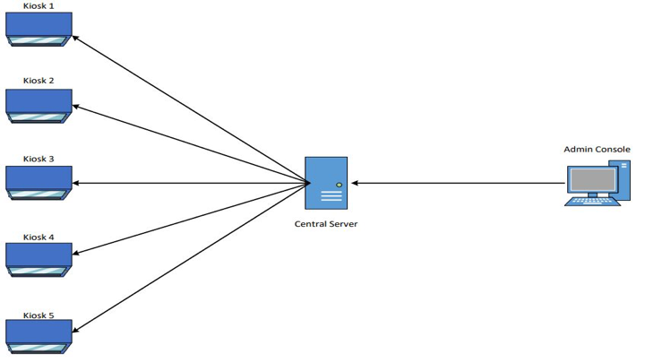
Implementation - AWS

Slide 25
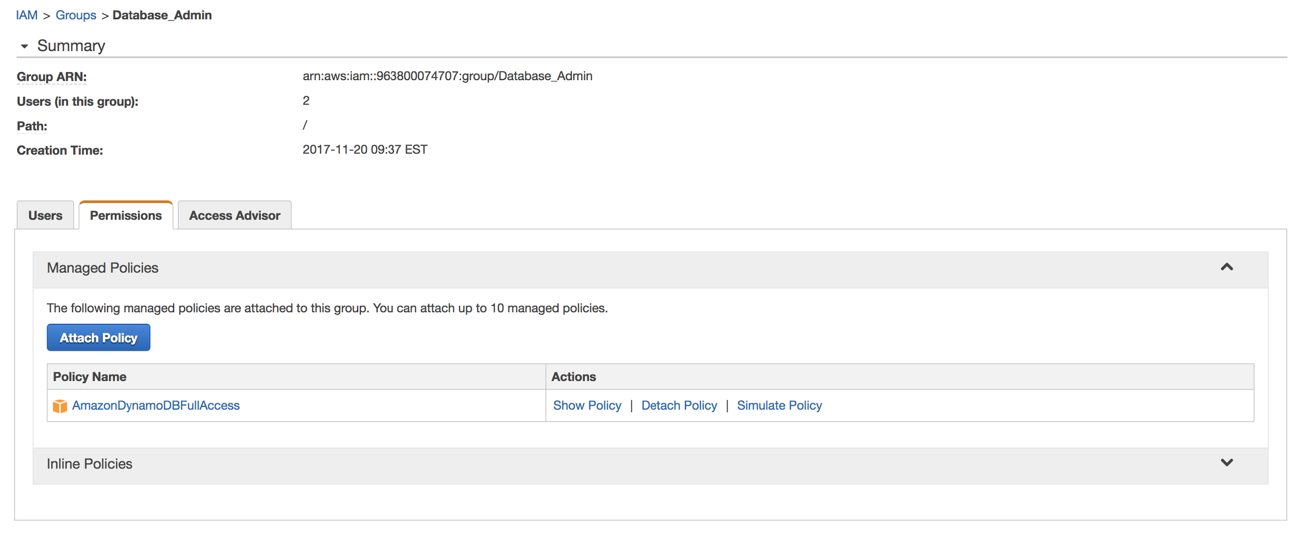
Security - Database
Does not interact with browser
We use Amazon Web Services Identity Access Managers (IAM) roles
Access keys

Slide 26

Security - Remote Server
Data Center and network architecture
AWS server

Slide 27
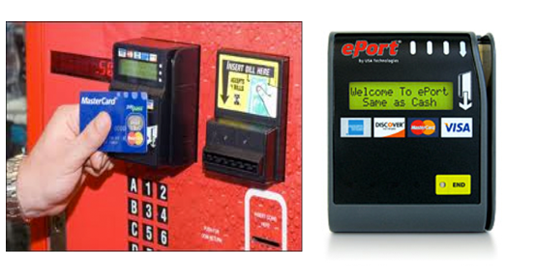
Security - Phyiscal
Does not interact with browser
Vandalism
Theft
Entry into the machine will require keys
Each key will be under the control of the Kiosk owner.

Slide 28

Maintenance
Software
Microsoft OS Documentation
Hardware
Touchscreen Documentation
Database
AWS Documentation
Application
Updating Products
Updating Pictures
Patches

Slide 29
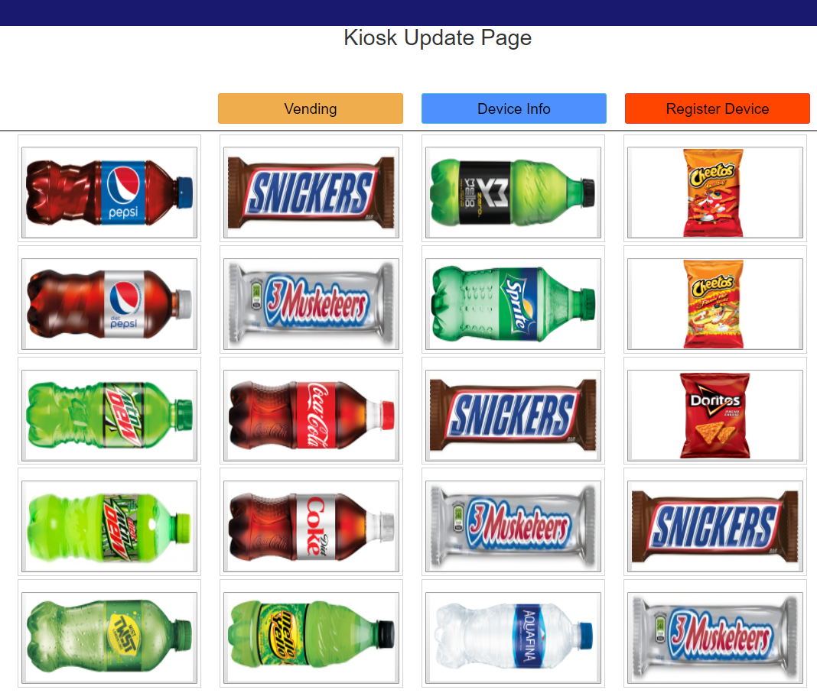
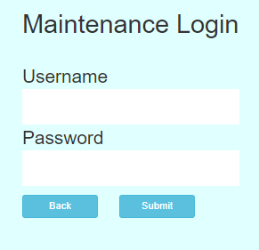
Maintenance Roles: Login
Login into Maintenance Role
Username
Password

Slide 30
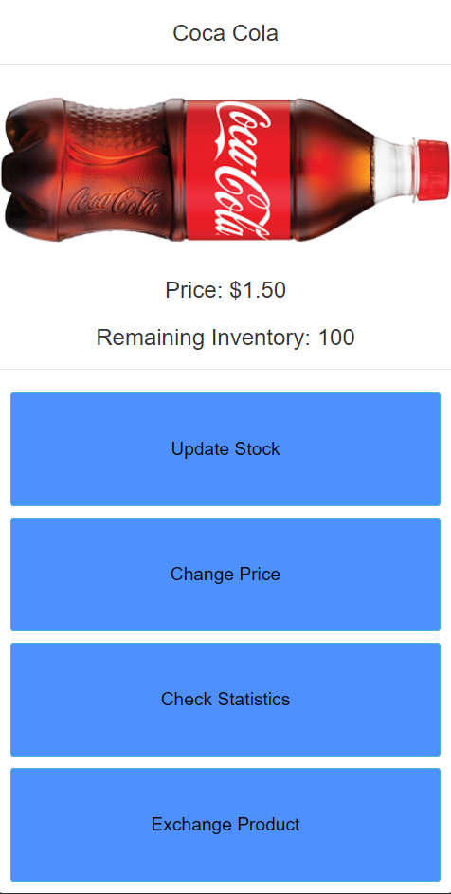
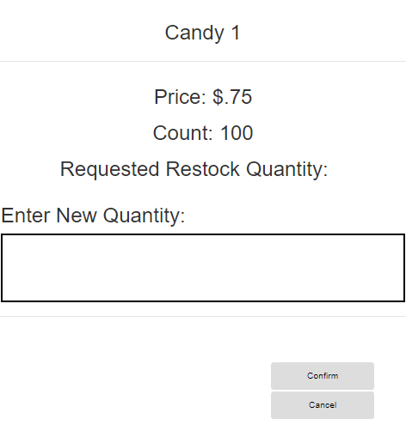
Maintenance Roles: Item Count
Login into Maintenance Role
Select Item
Select Update Items

Slide 31
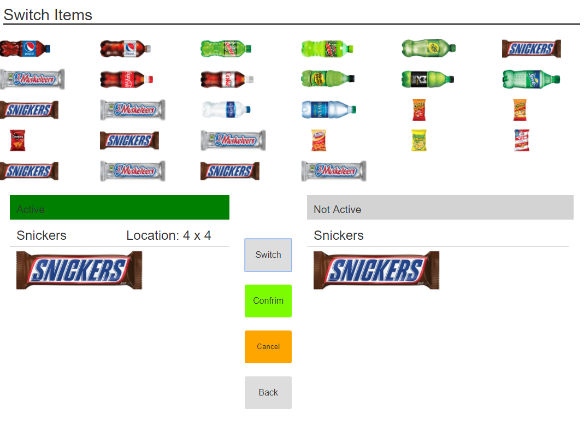
Maintenance Roles: Switch Items
Login Maintenance Role
Select two items
Confirm

Slide 32
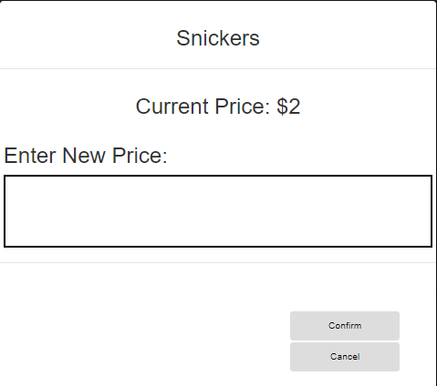
Maintenance Roles: Change Item Price
Select Item
Type in new price

Slide 33
Next Speaker: Andrew

Slide 34
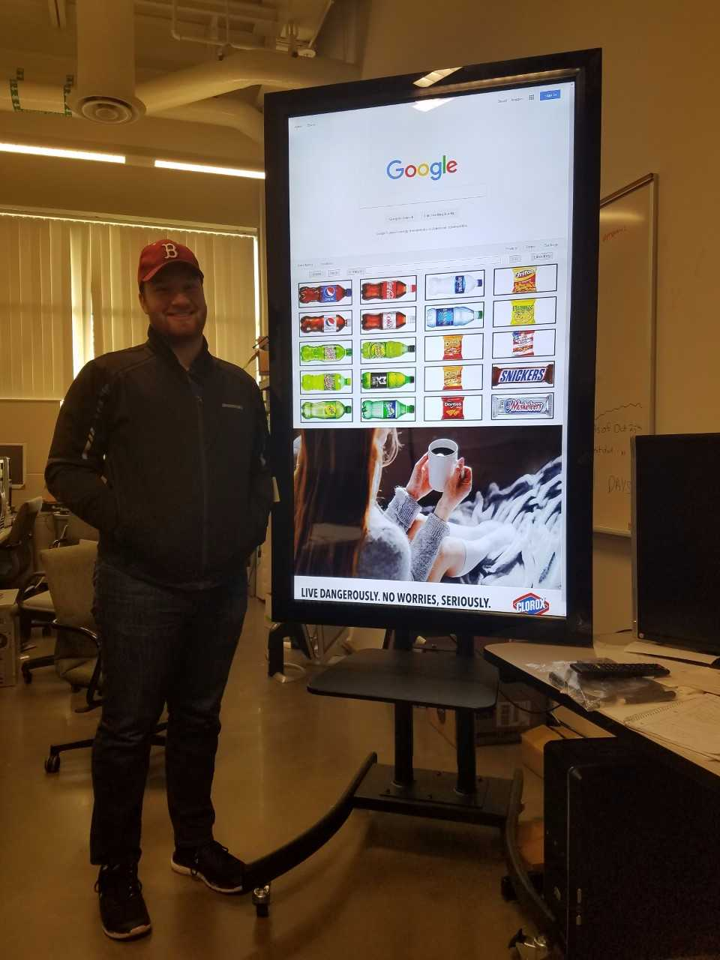
Testing
Angular 2 => Karma Unit Testing
Test each module created ran successfully.
Usability testing
Random person come in and have them perform task
Serach any webiste of their choice
Purchase any vending item

Slide 35
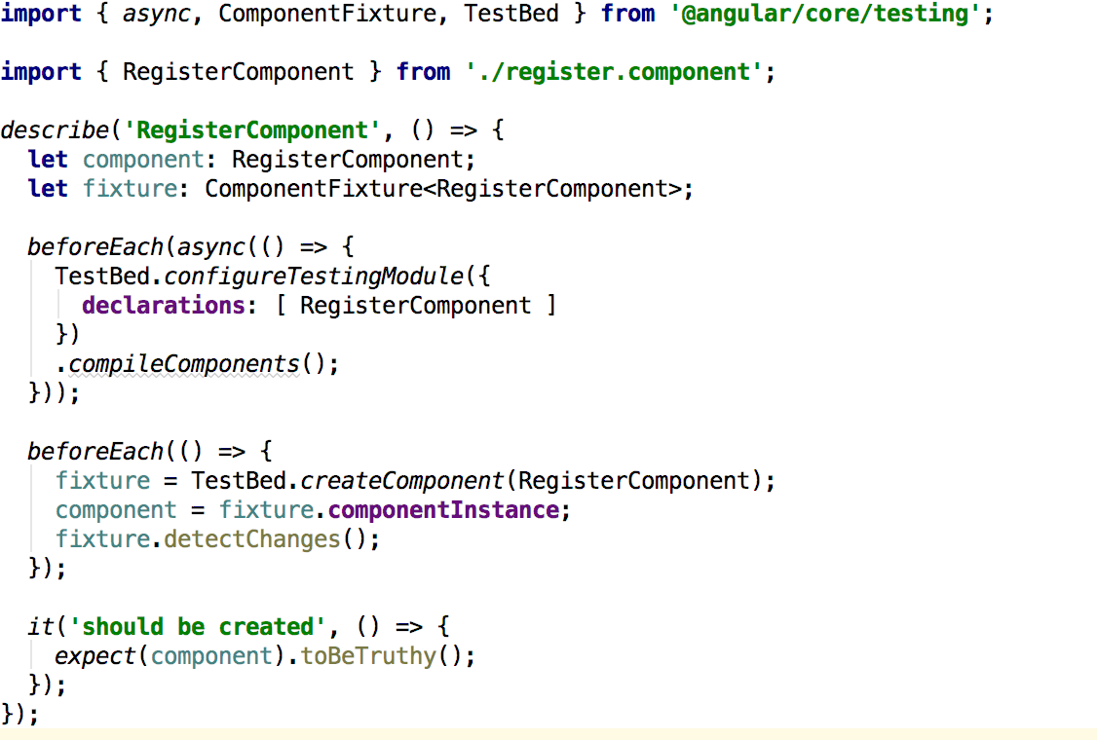
Karma Unit Testing Sample

Slide 36
Summary
This is release 1
Delivered November 28th

Slide 37
Release 2 Considerations
Product purchases
Physical/Virtual Currency
Not yet determined by client
Remote Access
Adding the capability to remote into a kiosk

Slide 38

Questions

